Slide 1
Data Structures
Mr. Ali Haider
School of CS & IT
Institute of Management Sciences, Peshawar, Pakistan

Slide 2
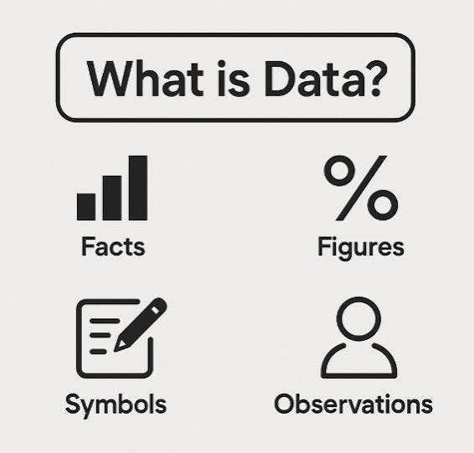
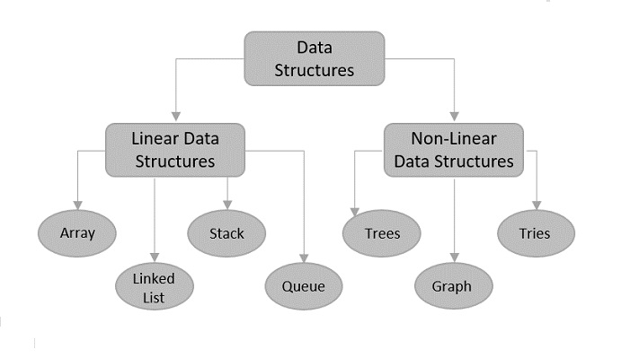
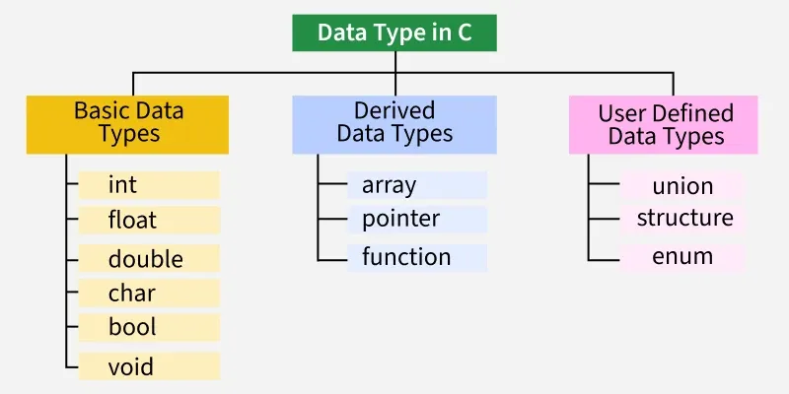
Question
What is Data?
What is Data Type?
What is Data Structure?

Slide 3
Definitions
Data is a collection of raw, unorganized facts, measurements, or figures that can be processed to create meaningful information.
A data type is a classification or attribute assigned to a piece of data that tells a computer system, compiler, or interpreter how to interpret, store, and manipulate its value.
A data structure is a specialized format for organizing, processing, storing, and retrieving data in a computer's memory so that it can be used efficiently.

Slide 4
Question
If you needed to store one student's name, roll number, and three test scores together, could a single data type do that job?

Slide 5
What Is a Data Structure?
In simple words: Sometimes one variable isn't enough - we need to group several related pieces of data (maybe of different types) and treat them as ONE unit.
Formal definition (quote/callout box): "A data structure is a named group of data of different data types which can be processed as a single unit."
Example: a Student Record (4 boxes)
Name (char[]) · Roll No. (int) · GPA (float) · Semester (int)
Caption: Four different data types, stored and processed together as ONE record - that grouping is a data structure.

Slide 6
Two Design Goals:
  Rich enough to reflect real relationships
  Simple enough to process efficiently.
Rule of thumb: If you're describing ONE value, that's a data type. If you're describing how MANY values relate to each other, that's a data structure.

Slide 7
Why Do We Need Data Structures?
Real Example: An Employee File
Each record: Name, Address, Phone, Age, Sex, Employee Number - stored and processed together.
Operation | Example
Traverse | Mail a meeting notice to every employee
Search | Find one employee's address by name
Insert | A new employee joins the company
Delete | An employee leaves the company

Slide 8
Everyday Analogies
Your phone Contacts app - organizes name, number, photo per contact
A library catalogue - organizes book, author, shelf location together
An online shopping cart - organizes item, price, and quantity as one line

Slide 9
Algorithms and Data Structures
Algorithm + Data Structure = Program
An algorithm is the step-by-step procedure that solves a task
A data structure is how the data involved is organized
The RIGHT data structure choice shapes how well the algorithm performs
Choosing an algorithm and its data structure together is what 'programming' means at its core

Slide 10
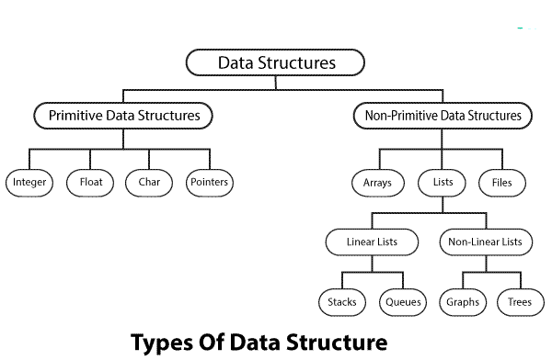
Classification of Data Structures
Primitive = built directly into the language. Non-Primitive = built by us, from primitives, to model real relationships.

Slide 11
Linear vs. Non-Linear Data Structures
LINEAR: Elements are arranged in a sequence, one after another.
Each element has exactly one predecessor and one successor
Examples: Arrays, Linked Lists, Stacks, Queues
Good for ordered, step-by-step data
NON-LINEAR: Elements branch out - one item can connect to several others.
Elements can have multiple connections (parent/child, or many neighbors)
Examples: Trees, Graphs
Good for hierarchical or networked data

Slide 12
Basic Operations on Data Structures
# | Operation | Description
1 | Traversing | Visit each element exactly once to process it
2 | Searching | Find whether/where a specific item exists
3 | Inserting | Add a new element into the structure
4 | Deleting | Remove an existing element
5 | Sorting | Arrange elements into ascending/descending order
6 | Merging | Combine two sorted structures into one sorted structure

Slide 13
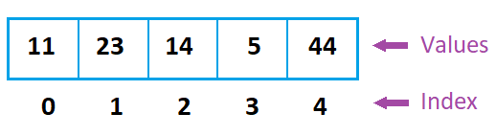
Arrays
A finite set of homogeneous (same-type) elements, stored in consecutive memory locations and accessed by an index.
Declaration: int A[10];
Key Facts:
First index is always 0
Elements sit in consecutive memory - fast direct access
Reading/writing needs a loop (one loop per dimension)
Size formula:
  (upper bound − lower bound) + 1 = (9 − 0) + 1 = 10

Slide 14
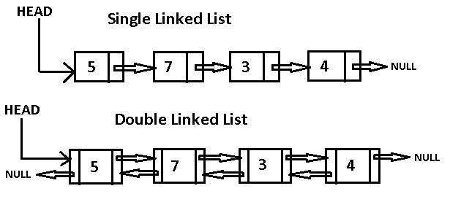
Linked Lists
A linear collection of nodes, where each node holds data AND a pointer to the next node.
Key points:
Each node = Info (the data) + Link (address of the next node)
The last node's link is NULL - marks the end of the list
Unlike arrays, nodes need NOT sit in consecutive memory

Slide 15
Stacks - Last In, First Out (LIFO)
Definition: insertion (push) and deletion (pop) both happen only at one end - the Top of Stack (TOS).
Analogy: a stack of plates at a buffet - you always take the top plate off, and always add a new one on top.
Two Core Operations:
  Push - add a new element on top of the stack
  Pop - remove the element currently on top
  The last element pushed is always the first one popped (LIFO)

Slide 16
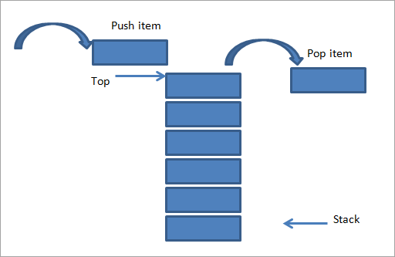

Slide 17
Queues - First In, First Out (FIFO)
Insertion happens at the REAR; deletion happens at the FRONT.
Analogy: a railway reservation line - new customers join at the back; whoever's been waiting longest is served first, from the front.
Two Core Operations:
  Enqueue - add a new element at the rear
  Dequeue - remove the element at the front
  10 was added first, so 10 leaves first; 80 was added last, so 80 leaves last

Slide 18
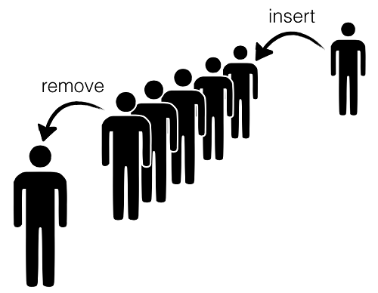
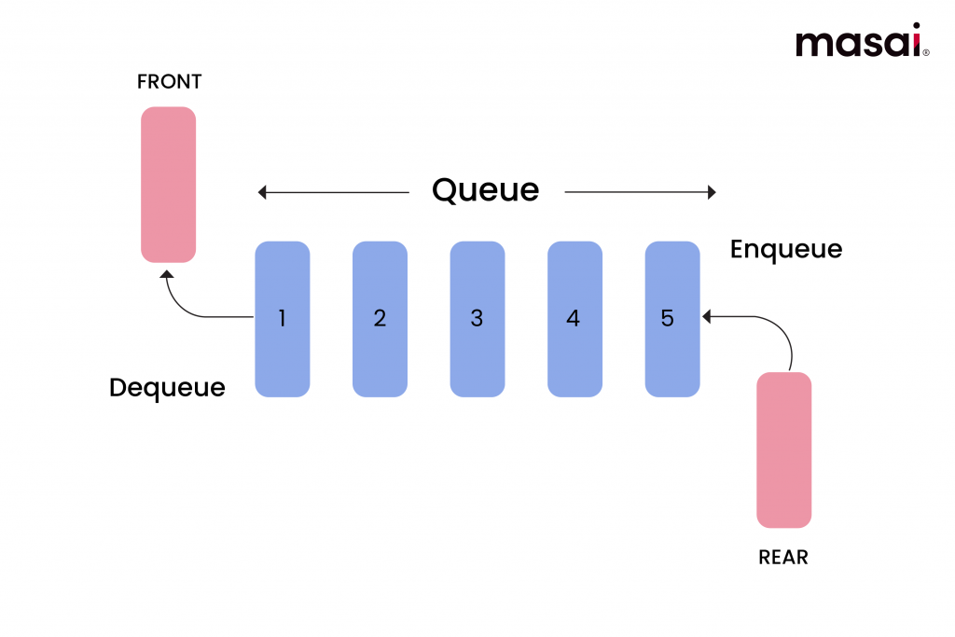

Slide 19
Trees - Hierarchical Structure
Definition: a finite set of nodes representing a hierarchical (parent-child) relationship, with one Root at the top.
Key points:
A is the Root; B and C are children of A, each heading its own subtree
Unlike natural trees, data structure trees are usually drawn growing DOWNWARD

Slide 20
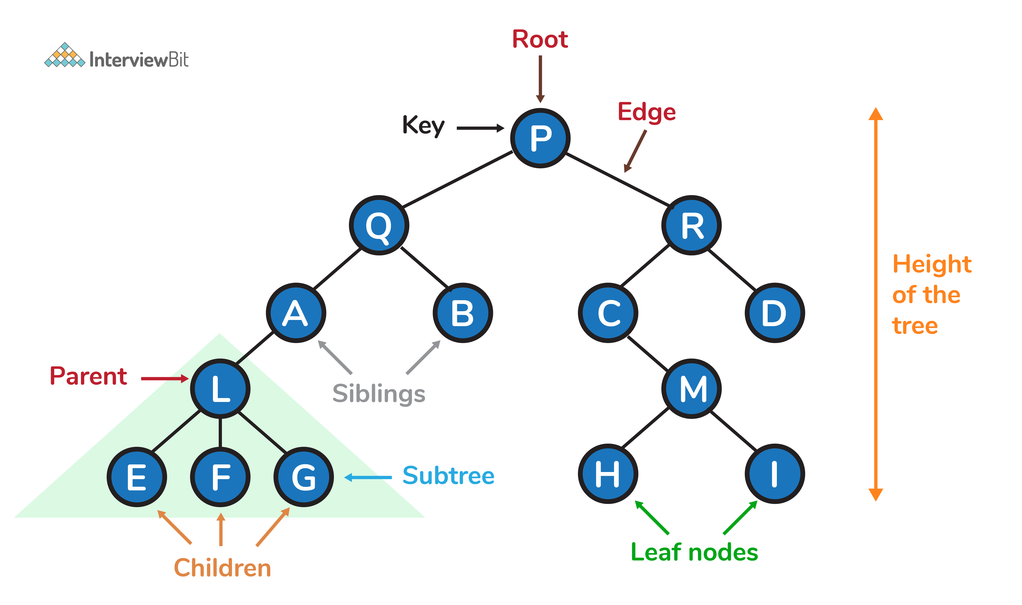

Slide 21
Graphs - Networks of Relationships
Definition: a graph G = (V, E) is a set of vertices (V) connected by edges (E) - the relationship need not be hierarchical.
Analogy: 5 villages separated by a river, connected by bridges. Villages = vertices; bridges = edges.
V(G) = { v1, v2, v3, v4, v5 }
E(G) = edges connecting village-pairs directly by a bridge
Key points:
A tree IS a graph, but a graph is NOT always a tree - graphs allow cycles and multiple paths
Real-world graphs: road networks, social networks, computer networks

Slide 22
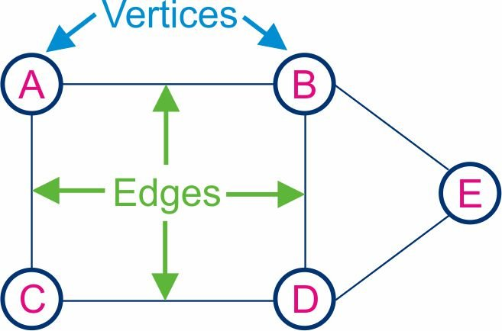

Slide 23
Why Data Structures Matter
Field | How Data Structures Show Up
Software Development | Every app - from a to-do list to a game engine - relies on choosing the right structure to store its data
Artificial Intelligence | Search trees, graphs, and queues power pathfinding, decision-making, and neural network pipelines
Databases | Indexes, B-Trees, and hash structures make searching millions of records feel instant
Cybersecurity | Hash tables and tries detect malware signatures and patterns; graphs model attack surfaces

Slide 24
Today's Big Ideas
A data structure organizes related data AND the relationships between it.
Data structures split into Primitive and Non-Primitive; Non-Primitive splits into Linear and Non-Linear.
Every structure supports core operations - traverse, search, insert, delete (plus sort & merge).
We previewed Arrays, Linked Lists, Stacks, Queues, Trees, and Graphs - each will get its own full lab.

Slide 25
Any Questions?

Slide 26
Thank You

